Slide 1
Lecture 01 Analysis of algorithms
CSE373: Design and Analysis of Algorithms

Slide 2
Algorithm
In simple terms, an algorithm is a series of instructions to solve a problem (complete a task)
Problems can be in any form
Business/Academia
How to maximize profit under certain constrains? (Linear programming)
Maximize the number of classes running in parallel
Life
Explain how to compute GCD to a 8 year old child
Explain how to tie a tie
We are often unaware that we are using algorithms in real life
In CS we must be super-aware of the details of algorithms we need
- because we need to translate these algorithms to computer so that it can work for us

Slide 3
Course Objective
The theoretical study of design and analysis of computer algorithms
Analysis:
Estimate the cost of an algorithm in terms of resources (e.g. memory, processor, bandwidth, etc.) and performance (time).
Prove why certain algorithm works (achieves its goal).
Requires very good understanding of discrete math and statistics
Design: design algorithms in such a way which minimize the cost and achieves its goal(s)
* I shall test whether you understood (both design & analysis) clearly instead of testing whether you can memorize or not.
(step by step instructions to achieve a goal)

Slide 4
Highlights of this course
Among the top 10 interview questions on algorithms, we shall learn
at least 5 graph algorithms
at least 4 dynamic programming algorithms
at lease 5 searching/sorting algorithms
And many other interesting algorithms and their analyses.

Slide 5
Motivation
Internal motivation
To learn some interesting tricks of designing efficient algorithms
To learn some interesting proof techniques to show the world that your algorithm indeed works
To learn interesting mathematical techniques to show the world that your algorithm is highly efficient even for the worst possible inputs.
External motivation
To be able to be hired by a top software company
To be able to achieve accolades in programming contests
To be able to do research on design and analysis of algorithms in theoretical CS, Data Mining, AI, etc.
Internal motivation > External motivation

Slide 6
Computational Problem
A computational problem can be represented as a question that describes the requirements of the desired output given an input. For e.g.
Is n a prime number? (n is a user input)
What are the prime factors of n? (n is a user input)
How many prime factors of n are there? (n is user input)
What is the maximum value of a[i]? (a[1…n] is an input array)

Slide 7
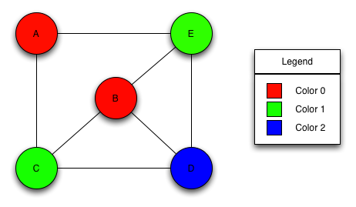
Common Types of Computational Problems
Decision Problems: given an input x, verify if x satisfies a certain property i.e., give YES/NO answer
3-coloring decision problem: given an undirected graph, G= (V,E), determine if there is a way to assign a “color” chosen from {0,1, 2} to each vertex in such a way that no two adjacent vertices have the same color
Path decision problem: Is there a path from A to D in graph G?

Slide 8
Common Types of Computational Problems
Search problem: given an input x, compute some answer y such that y satisfies a certain condition/requirement.
3-coloring search problem: given an undirected graph G = (V, E) find, if it exists, a coloring c: V → {1, 2, 3} of the vertices, such that for every (u, v) ∈ E: c(u) ≠ c(v)
Path search problem: Find all the paths from a to d in G
a
b
Find all the paths from a to d:
a →b →d
a →c →d
a →b →c →d
d
c

Slide 9
Common Types of Computational Problems
Counting Problem: Compute the number of solutions to a given search problem
3-coloring counting problem: given an undirected graph G = (V, E) compute the number of ways we can color the graph using 3 colors: {1,2,3} (while coloring we have to ensure that no two adjacent vertices have the same color).
Path counting Problem: Compute the number of possible paths from u to v in a given graph G.
a
b
Compute the number of paths from a to d: 3
d
c

Slide 10
Common Types of Computational Problems
Optimization Problems: Find the best possible solution among the set of all possible solutions to a search problem
Graph coloring optimization problem: given an undirected graph, G= (V,E), what is the minimum number of colors required to assign “colors” to each vertex in such a way that no two adjacent vertices have the same color
Path optimization problem: Find the shortest path(s) from u to v in a given graph G.
a
b
Find all the shortest paths from a to d:
a →b →d
a →c →d
d
c

Slide 11
Complexity of Computational Problems
Computational Problems can be categorized into different classes based on their complexity, such as:
Unsolvable problems: problems that can’t be solved by anyone or any machine ever
Class P problems: problems that are “efficiently/easily solvable” i.e.
Class NP problems: problems whose outputs can be “efficiently/easily verified”
Class NPC: class NP problems that are “hardest to solve”
….
We shall learn exactly what they mean later.

Slide 12
Algorithm
An algorithm is a finite sequence of precise instructions for performing a computation or for solving a problem.
It must produce the correct result
It must finish in some finite time
You can represent an algorithm using
pseudocode,
flowchart, or
even actual code
Algorithm
Input
Output

Slide 13
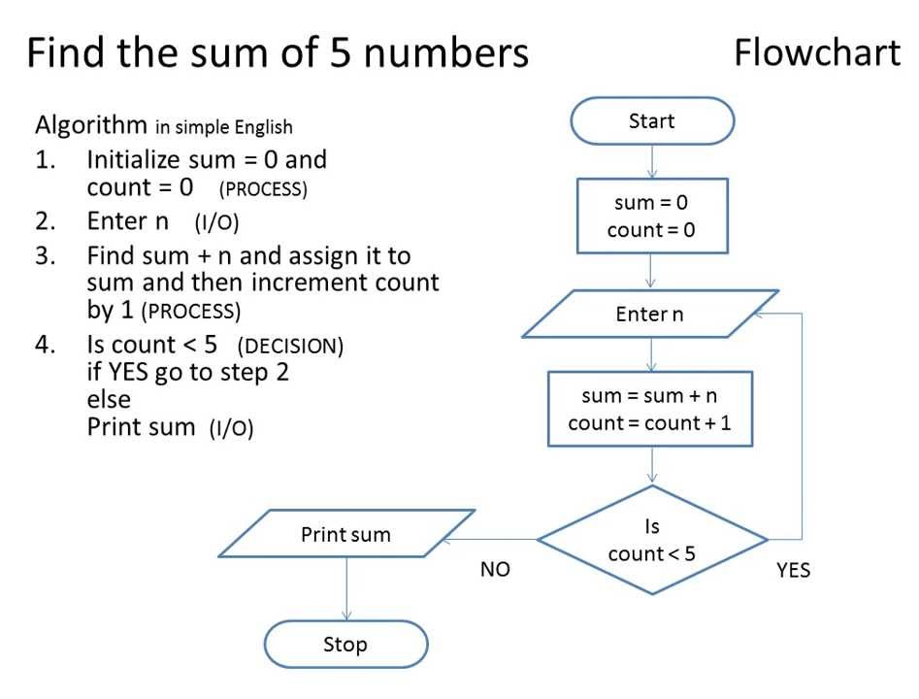
Algorithm Description : pseudocode vs flowchart

Slide 14
Some Important Types of Algorithms
Divide & Conquer (D&C) Algorithms
Greedy Algorithms
Dynamic Programming (DP) Algorithms

Slide 15
Complexity of Algorithms
How much resource is needed by an algorithm
Typically measured by
Time Complexity and/or
Space Complexity
Don’t mix-up problem complexity with algorithm complexity
Algorithm complexity deals with the complexity of a specific algorithm
Problem complexity indicates how hard the problem is. For e.g. NPC problems are so hard to solve that no matter how clever algorithm you design, it won’t be able to solve such a problem “easily/efficiently”.
Next we will illustrate how the problem of sorting numbers can be solved using an algorithm called “insertion-sort” (represented using the pseudocode convention of Cormen et al.)

Slide 16
The Problem of Sorting (Book: Chapter-2)
Input: sequence ⟨a₁, a₂, …, a_{n}⟩ of numbers.
Output: permutation ⟨a'₁, a'₂, …, a'_{n}⟩ such
that a'₁ ≤ a'₂ ≤ … ≤ a'_{n} .
Example:
Input: 8 2 4 9 3 6
Output: 2 3 4 6 8 9
Notes:
Reference: chapter 2 of Cormen

Slide 17
Insertion Sort Pseudocode
A[0] unused, valid elements: A[1] … A[n]
Algorithm Name with parameters (like a C function-header)
Comment
Equivalent CPP function
void insertionSort (int A[], int n)
{ //here A[0 . . n] is an int array
int i, j;
for (j = 2; j<=n; j++) {
key = A[ j];
i = j – 1;
while(i > 0 && A[i] > key){
A[i+1] = A[i];
i = i – 1;
}//while
A[i+1] = key;
}//for
}
INSERTION-SORT (A, n) ⊳ A[1 . . n]
for j ← 2 to n
do ⊳ Insert A[ j ] into the sorted subarray A[1..j -1]
⊳ in such a position that A[1..j] becomes sorted
key ← A[ j]
i ← j – 1
while i > 0 and A[i] > key
do A[i+1] ← A[i]
i ← i – 1
A[i+1] ← key
Algorithm body
For loop body
While
Loop
body
Indentation/spacing determines where
the algorithm/loop/if/else-body ends

Slide 18
Insertion Sort Simulation
i | j
1 | 2 | 3 | 4 | 5
7 | 4 | 9 | 5 | 1
INSERTION-SORT (A, n) ⊳ A[1 . . n]
for j ← 2 to n
do ⊳ Insert A[ j ] into the sorted subarray A[1..j -1]
⊳ in such a position that A[1..j] becomes sorted
key ← A[ j]
i ← j – 1
while i > 0 and A[i] > key
do A[i+1] ← A[i]
i ← i – 1
A[i+1] ← key
key
4
 | i | j
1 | 2 | 3 | 4 | 5
4 | 7 | 9 | 5 | 1
key
9
 |  | i | j
1 | 2 | 3 | 4 | 5
4 | 7 | 9 | 5 | 1
key
5
 |  |  | i | j
1 | 2 | 3 | 4 | 5
4 | 5 | 7 | 9 | 1
Loop Invariant: At the beginning of each iteration of the for loop, A[1..j-1] is already sorted
key
1
See Cormen Book (pp. 18-19) for the proof
1 | 2 | 3 | 4 | 5
1 | 4 | 5 | 7 | 9
Conclusion: when the for loop ends, j=n+1; so according to the loop invariant, A[1..(n+1-1)]=A[1..n]=A is sorted

Slide 19
Exercise
Q. Write the pseudo-code of the following algorithm
Algorithm Binary-Search(A, n, key):
//returns true if key is found in A[1..n]

Slide 20
Runtime/Time Complexity Analysis of Algorithms
To have an estimate about how much time an algorithm may take to finish for a given input size. (Running time aka. Time Complexity) analysis
Sometimes, instead of running time, we are interested in how much memory/space the algorithm may consume while it runs (space complexity)
It enables us to compare between two algorithms
What do we actually mean by running time analysis?
To determine in which rate running time increases as the problem size increases.
Size of the problem can be a range of things depending on the problem at hand, such as:
size of an array -- for e.g. for sorting/searching in an array
polynomial degree of an equation -- for e.g. for solving an equation
number of elements in a matrix – for e.g. for computing its determinant
number of bits in the binary representation of the input number – for e.g. for computing the bitwise not of an input number
….

Slide 21
Informal Notion of Running Time
Express runtime as a function of the input size n (i.e., as a function, f(n)) in order to understand how f(n) grows with n and
count only the most significant term of f(n) and ignore everything else (because those won’t affect running time much for very large values of n).
Thus the running times (also called time complexity) of the programs of the previous slide becomes:
f(N)= c₁N ≤ N*(some constant)
g(N) = (c1+c2+c3)N+(c1+c2) ≤ (c1+c2+c3)N = N*(some constant)
Thus both these functions are bounded (from above) by some constant multiple of N and as such both have the same upper bound: O(N). This means that, the running time of each of these algorithms is always less than or equal to a constant multiple of N; we ignore the values of constants in the Big Oh notation, i.e., we never write O(543N) [it is actually O(N)] or O(65N²+34N+7) [it is actually O(N²)].
We compare running times of different algorithms in an asymptotic manner (i.e., we check if f(n) > g(n) for very large values of n). That’s why, the task of computing time complexity (of an algorithm) is also called asymptotic analysis.

Slide 22
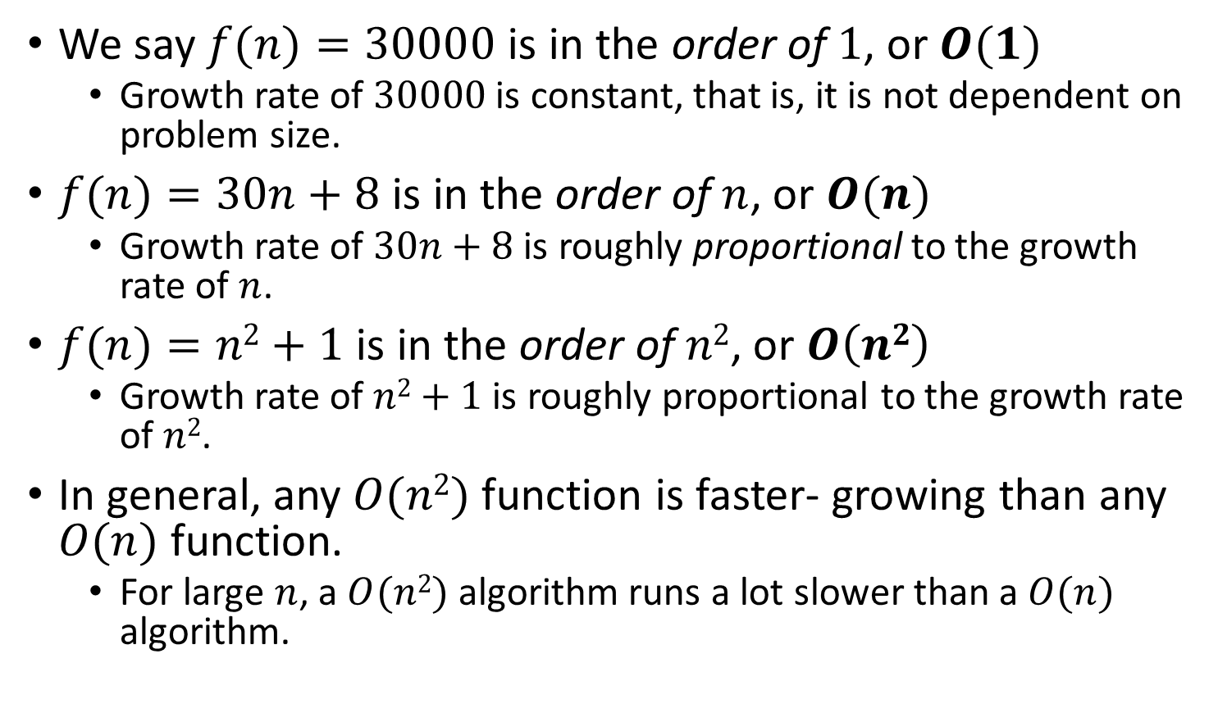
Big-Oh Notation Examples
We say $f(n)=30000$ is in the order of $1$, or $O(1)$
Growth rate of $30000$ is constant, that is, it is not dependent on problem size.
$f(n)=30n+8$ is in the order of $n$, or $O(n)$
Growth rate of $30n+8$ is roughly proportional to the growth rate of $n$.
$f(n)=n2+1$ is in the order of $n2$, or $O\left(n2\right)$
Growth rate of $n2+1$ is roughly proportional to the growth rate of $n2$.
In general, any $O(n2)$ function is faster- growing than any $O(n)$ function.
For large $n$, a $O(n2)$ algorithm runs a lot slower than a $O(n)$ algorithm.
→ Constant time
In general, O(n^{c1} (lgn)^{c2}) time is called polynomial time (here c1 and c2 are constants). For E.g. O(n²), O(n³), O(1), O(n lg n), O(n² lg n), O(n³ (lg n)²), etc.
→ Linear time
→ Quadratic time
O(2^{n}), O(4^{n}), etc., are called exponential times.

Slide 23
Visualizing Orders of Growth of Runtimes
On a graph, as you go to the right, a faster growing function eventually becomes larger.
f_{A}(n)=30n+8
Running time→
f_{B}(n)=n²+1
Increasing n →

Slide 24
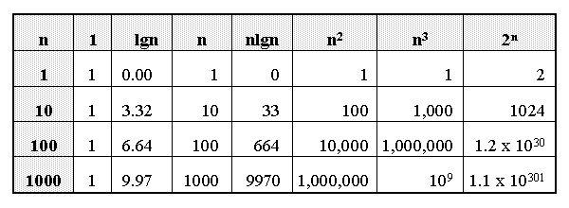
Growth of Functions

Slide 25
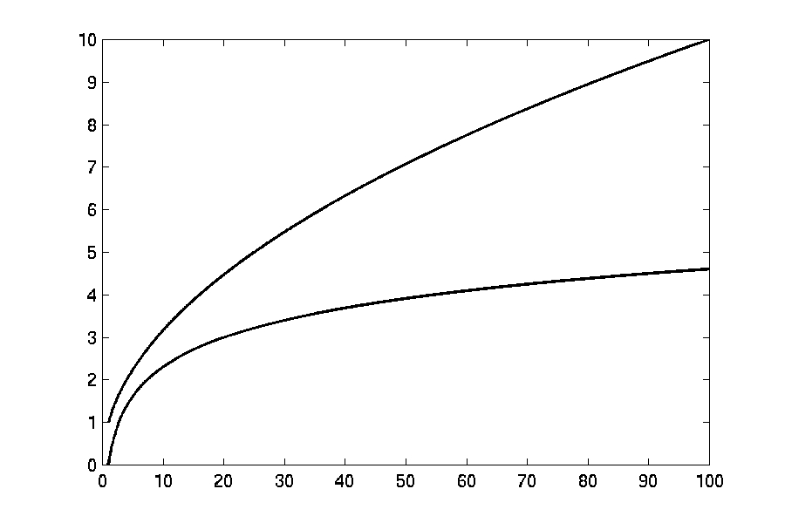
Complexity Graphs
log(n)

Slide 26
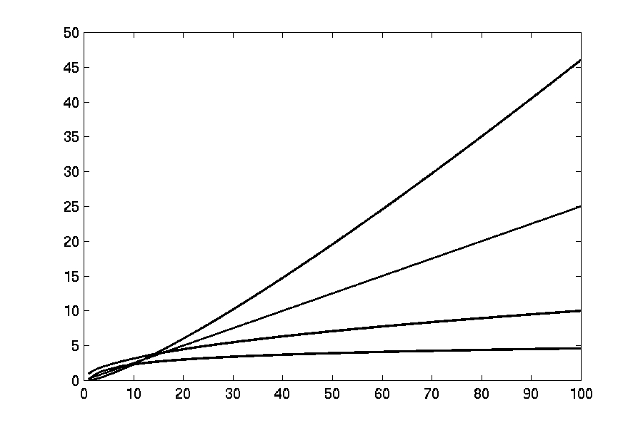
Complexity Graphs
n log(n)
n
log(n)

Slide 27
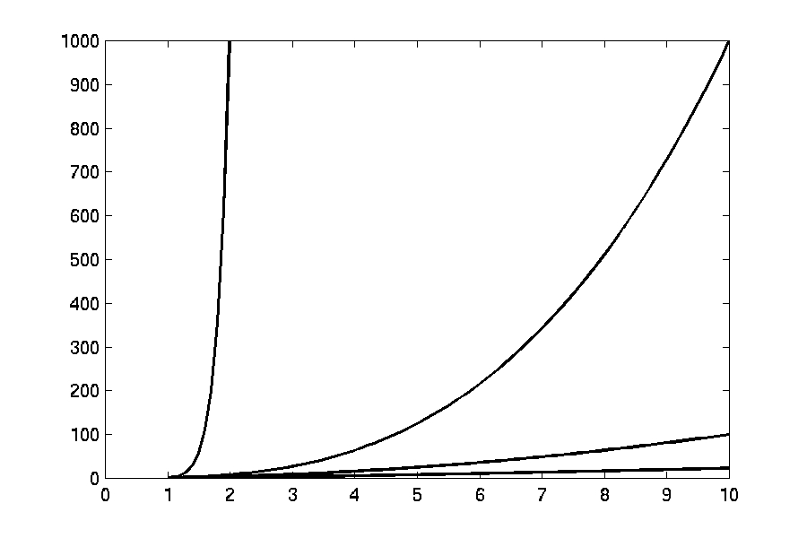
Complexity Graphs
n¹⁰
n³
n²
n log(n)

Slide 28
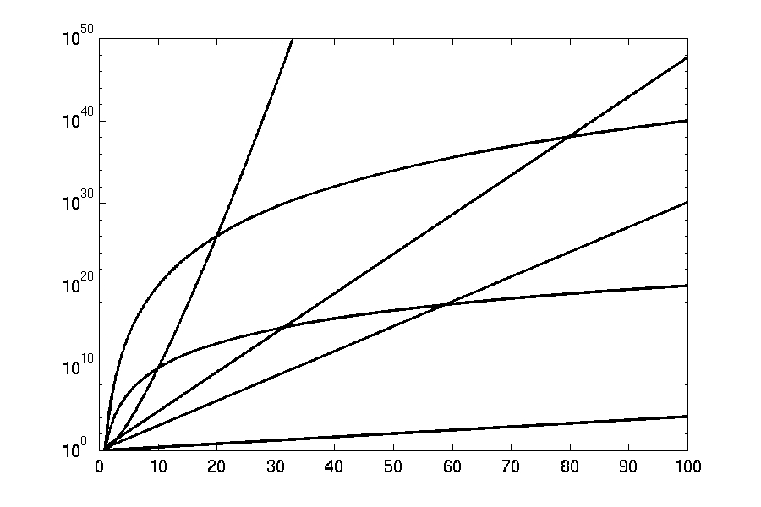
Complexity Graphs (log scale)
3^{n}
n^{n}
n²⁰
2^{n}
n¹⁰
1.1^{n}
Is it true that O(n²⁰) > O(2^{n})?
NO; O(n²⁰) < O(2^{n}) for very large values of n

Slide 29
Asymptotic Notations
O notation: asymptotic “upper bound”:
Ω notation: asymptotic “lower bound”:
Θ notation: asymptotic “tight bound”:

Slide 30
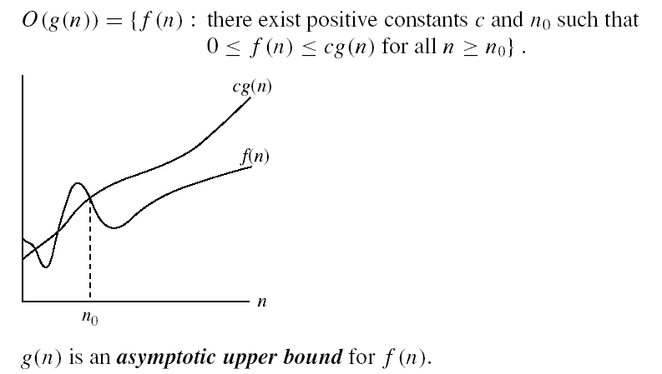
Asymptotic Notations
O-notation (Big Oh)
O(g(n)) is the set of functions with smaller or same order of growth as g(n)
f(n) is O(g(n))
Examples:
T(n) = 3n²+10nlgn+8 is O(n²), O(n²lgn), O(n³), O(n⁴), …
T’(n) = 52n²+3n²lgn+8 is
O(n²lgn), O(n³), O(n⁴), …
Loose upper bounds
This means that f(n) is bounded from above by a constant multiple of g(n)

Slide 31
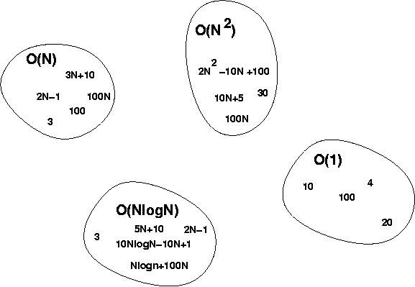
Big-Oh Visualization

Slide 32
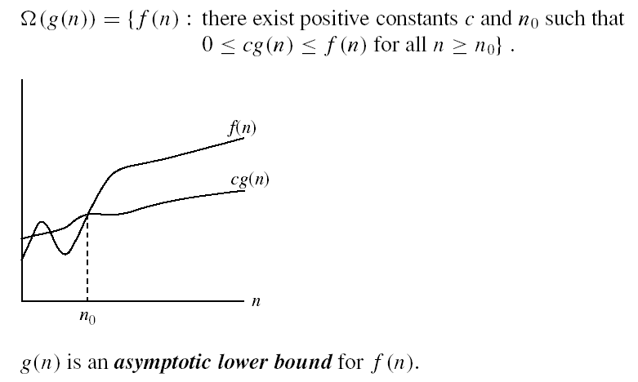
Asymptotic Notations
Ω - notation (Big Omega)
Ω(g(n)) is the set of functions with larger or same order of growth as g(n)
f(n) is Ω(g(n))
Examples:
T(n)=3n²+10nlgn+8 is Ω(n²), Ω(nlgn), Ω(n), Ω(lgn),Ω(1)
T’(n) = 52n²+3n²lgn+8 is Ω(n²lgn), Ω(n²), Ω(n), …
Loose lower bounds
This means that f(n) is bounded from below by a constant multiple of g(n)

Slide 33

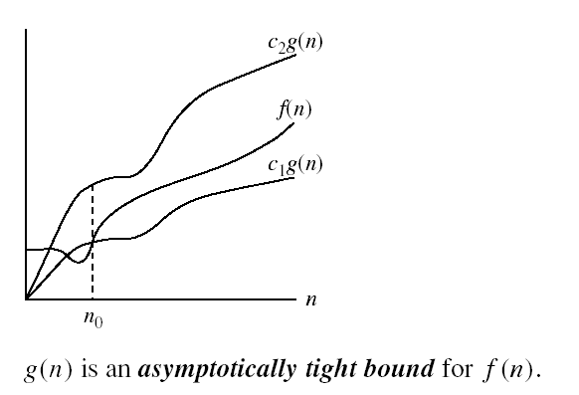
Asymptotic Notations
Θ-notation (Big Theta)
Θ(g(n)) is the set of functions with the same order of growth as g(n)
* f(n) is both O(g(n)) & Ω(g(n)) ↔ f(n) is Θ(g(n))
Examples:
T(n) = 3n²+10nlgn+8 is Θ(n²)
T’(n) = 52n²+3n²lgn+8 is Θ(n²lgn)
This means that f(n) is bounded from above and below by constant multiples of g(n), i.e., f(n) is roughly proportional to g(n)

Slide 34
Some Examples
Determine the time complexity for the following algorithm.
count = 0; //c₁
i = 0; //c₁
while(i < n){ //(n+1)c₂
count++; //nc₃
i++; //nc₃
}
So total time taken by this code,
T(n) = (2c₁ + c₂) + n (c₂+2c₃) which is ≤ (2c₁+ 2c₂+2c₃) n
for very large values of n. Therefore we say that the time complexity of this code is O(n).
Usually, when the code is very simple (like above), we simply say that the runtime of this code is O(n), without doing the straightforward mathematical analysis. When the code is not so simple, we do the actual analysis to compute the time complexity.

Slide 35
Some Examples
Determine the time complexity for the following algorithm.
count = 0;
for(i=0; i<10000; i++)
count++;

Slide 36
Some Examples
Determine the time complexity for the following algorithm.
count = 0;
for(i=0; i<10000; i++)
count++;
Θ(1)

Slide 37
Some Examples
Determine the time complexity for the following algorithm.
count = 0;
for(i=0; i<n; i++)
count++;

Slide 38
Some Examples
Determine the time complexity for the following algorithm.
count = 0;
for(i=0; i<n; i++)
count++;
Θ(n)

Slide 39
Some Examples
Determine the time complexity for the following algorithm.
sum = 0;
for(i=0; i<n; i++)
for(j=0; j<n; j++)
sum += arr[i][j];

Slide 40
Some Examples
Determine the time complexity for the following algorithm.
sum = 0;
for(i=0; i<n; i++)
for(j=0; j<n; j++)
sum += arr[i][j];
Θ(n²)

Slide 41
Some Examples
Determine the time complexity for the following algorithm.
sum = 0;
for(i=1; i<=n; i=i*2)
sum += i;

Slide 42
Some Examples
Determine the time complexity for the following algorithm.
sum = 0;
for(i=1; i<=n; i=i*2)
sum += i;
Θ(lg n)
WHY? Show mathematical analysis to prove that it is indeed Θ(lg n)
Notes:
Do analysis in class-note

Slide 43
Some Examples
Determine the time complexity for the following algorithm.
sum = 0;
for(i=1; i<=n; i=i*2)
for(j=0; j<n; j++)
sum += i*j;

Slide 44
Some Examples
Determine the time complexity for the following algorithm.
sum = 0;
for(i=1; i<=n; i=i*2)
for(j=0; j<n; j++)
sum += i*j;
Θ(n lg n)
Why? Outer for loop runs Θ(lg n) times (prove it!) and for each iteration of outer loop, the inner loop runs Θ(n) times

Slide 45
Some Examples
Determine the time complexity for the following algorithm.
sum = 0;
for(i=1; i<=n; i=i*2)
for(j=0; j<i; j++)
sum += i*j;

Slide 46
Some Examples
Determine the time complexity for the following algorithm.
sum = 0;
for(i=1; i<=n; i=i*2)
for(j=0; j<i; j++)
sum += i*j;
Loose Upper Bound: O(n lg n)
Tight Upper Bound: O(n)
Asymptotic Tight Bound: Θ(n)
WHY?

Slide 47
Does implementation matter?
Determine the time complexity for the following algorithm.
char str[100];
gets(str); //let strlen(str) = n
for(i=0; i<strlen(str); i++)
str[i] -= 32;

Slide 48
Does implementation matter?
Determine the time complexity for the following algorithm.
char someString[10];
gets(someString);
for(i=0; i<strlen(someString); i++)
someString[i] -= 32;
Θ(n²)

Slide 49
Does implementation matter?
char someString[10];
gets(someString);
for(i=0; i<strlen(someString); i++)
someString[i] -= 32;
Can we re-implement it to make it more efficient?
char someString[10];
gets(someString);
int t = strlen(someString);
for(i=0; i<t; i++)
someString[i] -= 32;
Θ(n²)
YES
Θ(n)
This example shows that a badly implemented algorithm may have greater time complexity than a more efficient implementation

Slide 50

So far, we have been able to ALWAYS determine time complexity of an algorithm from the input size only. But is input size enough to determine time complexity unambiguously?
int find_a(char *str)
{
int i;
for (i = 0; str[i]; i++)
{
if (str[i] == ’a’)
return i;
}
return -1;
}
Time complexity: $O(n)$
Consider two inputs: “alibi” and “never”
What is the time complexity of the above algorithm?
Depends on the input (str):
Θ(1) for best possible input which starts with ‘a’ e.g. when str = “alibaba”
Θ(n) for worst possible input which doesn’t contain any ‘a’ e.g. when str = “nitin”

Slide 51
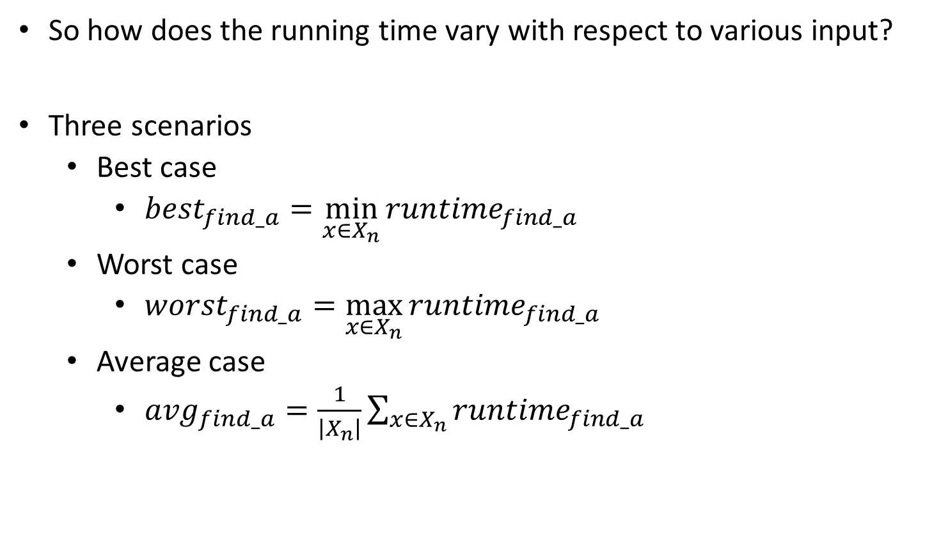
Types of Time Complexity Analysis
So how does the running time vary with respect to various input?
Three scenarios
Best case
$${best}_{find_a}=\min_{x∈X_{n}}{{runtime}_{find_a}}$$
Worst case
$${worst}_{find_a}=\max_{x∈X_{n}}{{runtime}_{find_a}}$$
Average case
$${avg}_{find_a}=\frac{1}{\left|X_{n}\right|}{\sum_{x∈X_{n}}{{runtime}_{find_a}}}$$

Slide 52
Types of Time Complexity Analysis
Worst-case: (usually done)
Running time on worst possible input
Best-case: (bogus)
Running time on best possible input
Average-case: (sometimes done)
We take all possible inputs and calculate computing time for all of the inputs sum all the calculated values and divide the sum by total number of inputs
We must know (or predict) distribution of inputs to calculate this
Often we compute it on an assumed distribution of inputs using expectation, in which case it is called Expected running time
This is typically calculated to show that although our algorithm’s worst case running time is not better, its expected time is better than its competitors
Amortized running time (discussed later)
We are typically interested in the runtime of an algorithm in the worst case scenario. Because it provides us a guarantee that the algorithm won’t take any longer than this, no matter which input is given.

Slide 53

Example of Best & Worst Case Analysis
Is input size everything that matters?
int find_a(char *str)
{
int i;
for (i = 0; str[i]; i++)
{
if (str[i] == ’a’)
return i;
}
return -1;
}
Time complexity: $O(n)$
Consider two inputs: “alibi” and “never”
Best case input: strings that contain an ‘a’ in its first index
Best case time complexity: O(1)
Worst case input: strings that do not contain any ‘a’
Worst case time complexity: O(n)
Average time complexity: O(n), how?
Notes:
Proof of average case analysis is done in class

Slide 54
Insertion Sort Algorithm Revisited
INSERTION-SORT (A, n) ⊳ A[1 . . n]
for j ← 2 to n
do key ← A[ j]
i ← j – 1
while i > 0 and A[i] > key
do A[i+1] ← A[i]
i ← i – 1
A[i+1] = key
What is the time complexity?
Depends on arrangement of numbers in the input array.
How can you arrange the input numbers so that this algorithm becomes most inefficient (worst case)?
How can you arrange the input numbers so that this algorithm becomes most efficient (best case)?

Slide 55
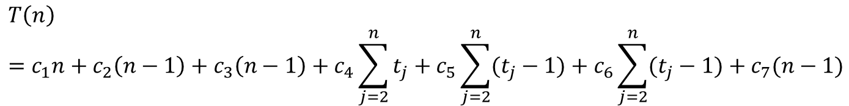
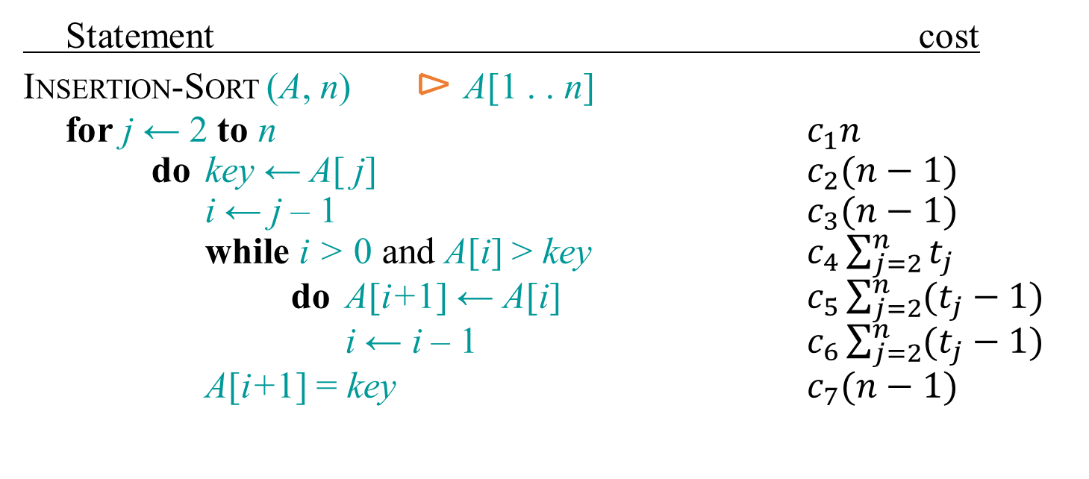
Insertion Sort: Running Time
Statement cost
INSERTION-SORT (A, n) ⊳ A[1 . . n]
for j ← 2 to n $c_{1}n$
do key ← A[ j] $c_{2}(n−1)$
i ← j – 1 $c_{3}(n−1)$
while i > 0 and A[i] > key $c_{4}\sum_{j=2}^{n}{t_{j}}$
do A[i+1] ← A[i] $c_{5}\sum_{j=2}^{n}{(t_{j}−1)}$
i ← i – 1 $c_{6}\sum_{j=2}^{n}{(t_{j}−1)}$
A[i+1] = key $c_{7}(n−1)$
$$T\left(n\right)={c_{1}n+c}_{2}\left(n−1\right)+c_{3}\left(n−1\right)+c_{4}\sum_{j=2}^{n}{t_{j}}+c_{5}\sum_{j=2}^{n}{(t_{j}−1)}+c_{6}\sum_{j=2}^{n}{(t_{j}−1)}+c_{7}(n−1)$$
Here t_{j} = no. of times the condition of while loop is tested for the current value of j.
How can we simplify T(n)? Hint: compute the value of T(n) in the best/worst case

Slide 56
Insertion Sort: Running Time
Statement cost
INSERTION-SORT (A, n) ⊳ A[1 . . n]
for j ← 2 to n $c_{1}n$
do key ← A[ j] $c_{2}(n−1)$
i ← j – 1 $c_{3}(n−1)$
while i > 0 and A[i] > key $c_{4}\sum_{j=2}^{n}{t_{j}}$
do A[i+1] ← A[i] $c_{5}\sum_{j=2}^{n}{(t_{j}−1)}$
i ← i – 1 $c_{6}\sum_{j=2}^{n}{(t_{j}−1)}$
A[i+1] = key $c_{7}(n−1)$
If you are asked to compute worst case time of Insertion-Sort, just say that the while loop runs j times for worst possible input i.e. reverse sorted array (explain why) and then compute T(n) from T(n) = Σ^{n}_{j=2} (j) = …. = n(n+1)/2 – 1 which is O(n²)
You don’t really need to show such a detailed calculation as shown here & in the book.
$$T\left(n\right)={c_{1}n+c}_{2}\left(n−1\right)+c_{3}\left(n−1\right)+c_{4}\sum_{j=2}^{n}{t_{j}}+c_{5}\sum_{j=2}^{n}{(t_{j}−1)}+c_{6}\sum_{j=2}^{n}{(t_{j}−1)}+c_{7}(n−1)$$
Here t_{j} = no. of times the condition of while loop is tested for the current value of j.
In the worst case (when input is reverse-sorted), in each iteration of the for loop, all the j-1 elements need to be right shifted, i.e., t_{j}=(j-1)+1 = j :[1 is added to represent the last test]. Putting this in the above eq., we get: T(n) = An²+Bn+C → O(n²), where A, B, C are constants.
What is T(n) in the best case (when the input numbers are already sorted)?

Slide 57
Polynomial & non-polynomial time algorithms
Polynomial time algorithm: Algorithm whose worst-case running time is polynomial
E.g.: Linear Search (in unsorted array): O(n), Binary Search (in sorted array): O(lg n), InsertionSort: O(n²), etc.
Non-polynomial time algorithm: Algorithm whose worst-case running time is not polynomial
Examples: an algorithm to enumerate and print all possible orderings of n persons: O(n!), an algorithm to enumerate and print all possible binary strings of length n: O(2^{n})

Slide 58
Amortized Analysis (Section 17.1)
Amortized Running Time: average time taken by an operation in a sequence of operations on a given data structure (doesn’t give time of a single operation).
Example: Consider MultipoppableStack data structure:- it supprts 3 operations on a stack:
PUSH(x) -> takes O(1) time
POP() -> takes O(1) time
MULTIPOP(k) //pops top k items from the stack
while not STACK-EMPTY() and k>0
do POP()
k=k-1
Let’s consider a sequence of n PUSH, POP & MULTIPOP operations
An e.g. of such a sequence of n=9 operations is: <PUSH, PUSH, POP, PUSH, PUSH, MULTIPOP(2), PUSH, PUSH, MULTIPOP(3)>
Notes:
Reference: Section 17.1 of Cormen

Slide 59
Example of Amortized Analysis (Contd.)
MULTIPOP = just a # of POP calls; so we need to count only the total # of PUSHs and POPs in the sequence.
Each object can be POPed only once for each time it is PUSHed. Therefore
total # of POPs (including POP calls in MULTIPOP)
≤ total # of PUSHs ≤ total # of operations = n.
Also, total # of PUSHs ≤ n
Therefore total # of PUSH+POP calls ≤ 2n
Each PUSH/POP operation takes O(1); so total time taken by the sequence of operations is ≤ 2nO(1) i.e., O(n)
There are n operations in the sequence, so in average, each operation takes O(n)/n which is O(1)
⸫ Amortized running time of an operation on MultipoppableStack is O(1)

